Slide 1
CollegeBoard
Analysis on 2001 Data
Aakash Tandel
June 29th 2017

Slide 2
Objective:
Analyze SAT data by state through exploratory data analysis

Slide 3
Questions:
Which states have large proportions of students taking the SAT?
Which states have high average verbal or math scores?
Is there a correlation between the rate of students taking the SAT Exam and that state’s verbal and math scores?

Slide 4
SAT Rates

Slide 5
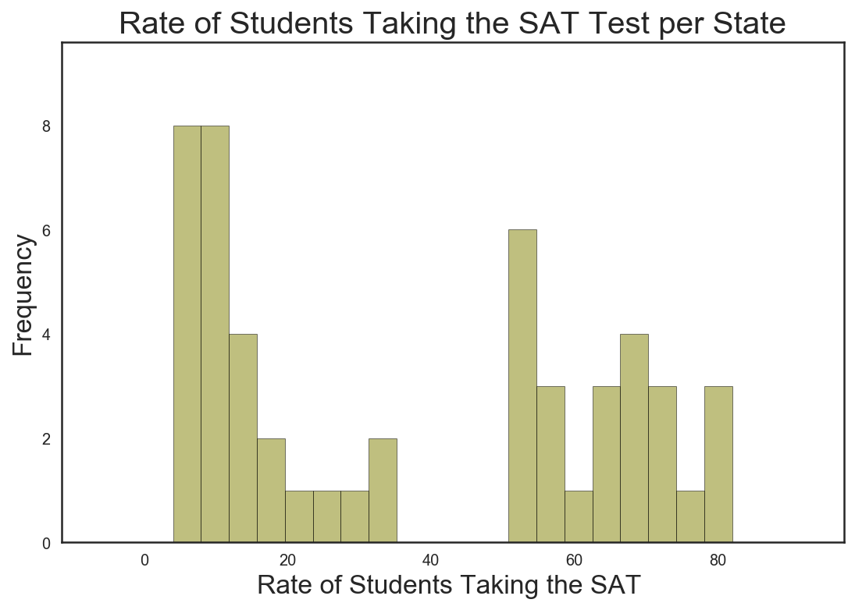
Notes:
Average is 37 . Bimodal

Slide 6
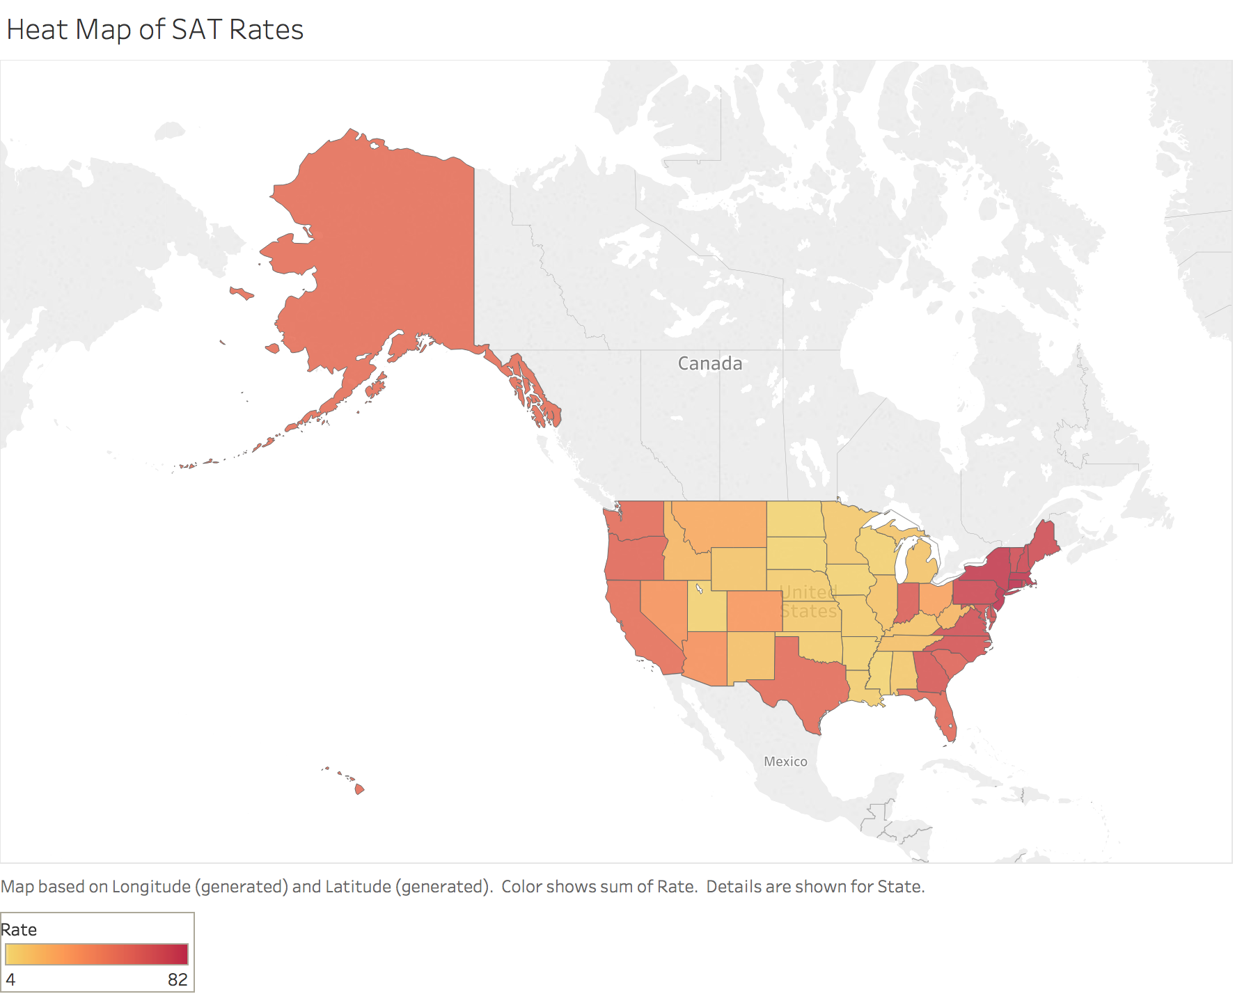
df
Notes:
Highest is CT at 82%. Lowest are Minn, SD, ND 4%.
Made in tableau. Simply taking the rate and applying it to a heat map

Slide 7
Average SAT Verbal Scores

Slide 8
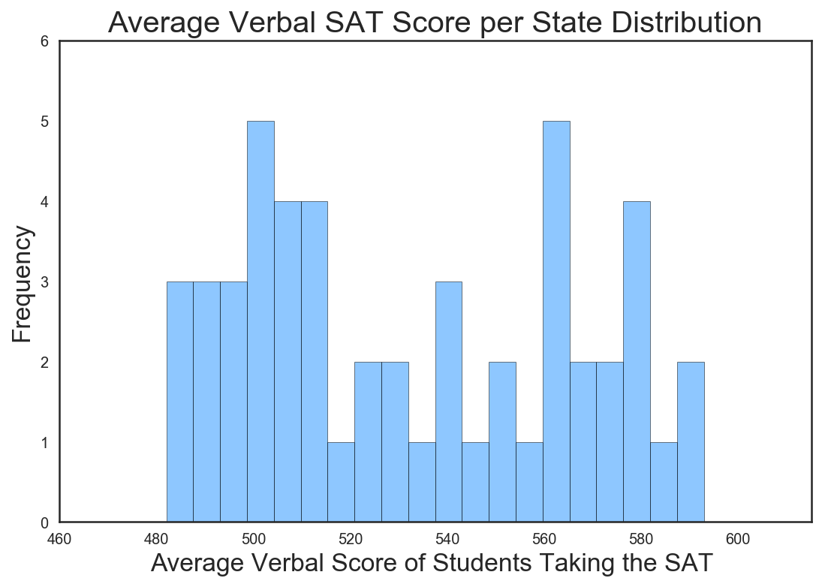
Notes:
Mean - 533 bimodal

Slide 9
Average SAT Math Scores

Slide 10
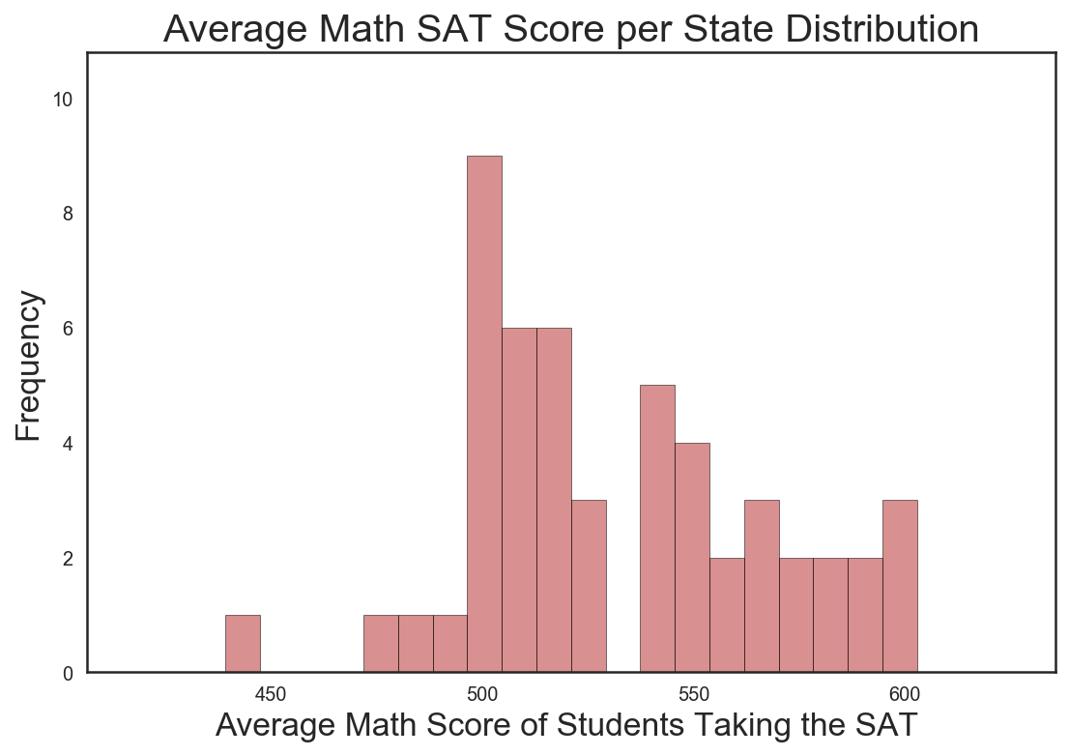
Notes:
Mean - 530 Could be normally distributed

Slide 11
Correlation between Rates and Scores

Slide 12
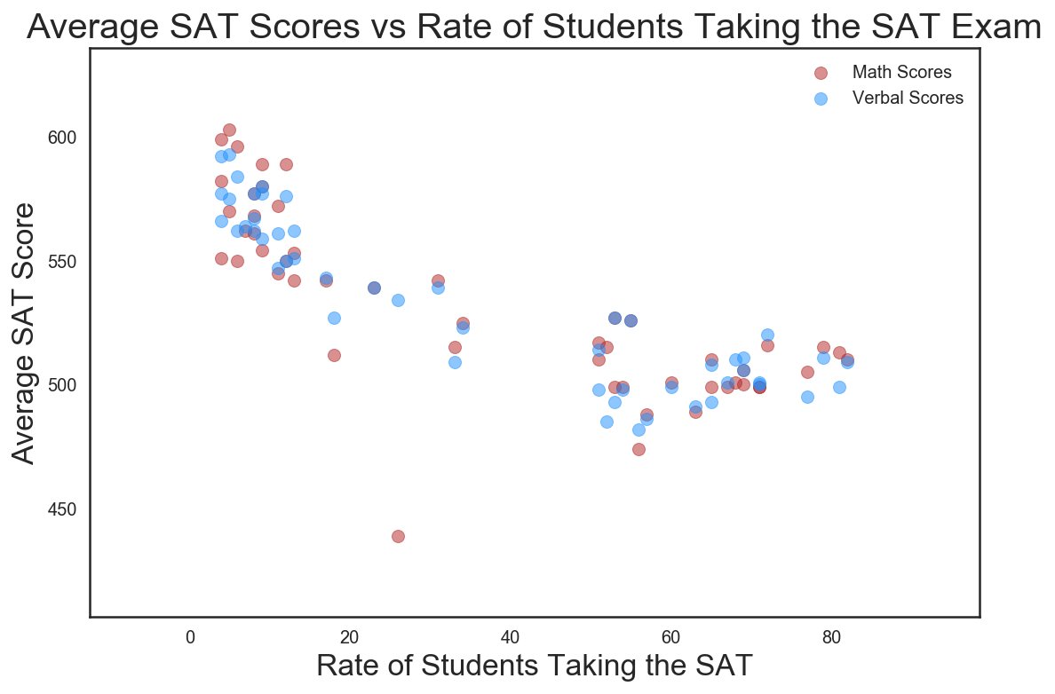
Notes:
Negative trend. This may not be causation but it is correlation.

Slide 13
Next Steps

Slide 14
More Data
Time Series Data
Raw Data
Competitor Data - ACT
Regression Analysis
Notes:
We could use time series data to see how the rates of students taking the exam change over time. This will be good for the College Board to know.
Raw data on individual scores may be more beneficial because with the mean, each state is effectively weighted equally when we know that some states have low rates of taking the exams and others do not.
Data on the ACT.
Using regression analysis to find out what are the causal effects on SAT test score rates.

